Slide 1
SNIFFPRO
A Network Monitoring System
Summer Project
Abhijith Varma A - 2022115003
Rishi Kumar U - 2022115085
Rohith S - 2022115305
Project Guide : Dr. K. Vidya

Slide 2
Introduction
Introduction to Network Monitoring:
Network traffic monitoring is essential for identifying issues such as performance bottlenecks, and abnormal behavior in networks.
The ability to capture and analyze packets in real-time is crucial for understanding the flow of data across a given network.
Network traffic monitoring helps optimize bandwidth usage by identifying high-traffic areas and potential congestion points, allowing network administrators to allocate resources more efficiently and ensure smooth network operations.
By continuously monitoring network traffic, administrators can detect and address issues such as network downtime, slow response times, and service outages before they escalate, ensuring minimal disruption to business operations and improved user experience.

Slide 3
Problem Definition
The main problem we have at hand is to tackle the challenges that the existing network analysis tools have. Some of them are :
Existing tools like Wireshark are too complex for new users, hence having a huge learning curve.
There is limited scope for proper visualisation of data.
Lack of utilisation of modern Artificial Intelligence techniques to draw out the niches and complexities of packet data, hence being able to analyse it better.
Our aim is to build a full-fledged application that can tackle all these problems at once, while also providing a user friendly experience with advanced packet analysis.

Slide 4
Objective
Primarily, our goals would be :
To develop a network sniffing and analysis tool that balances high performance with ease of usage and a modern user interface.
Develop modules that contribute to real-time data capture and analysis with minimal latency.
Create a clean and responsive user interface that allows user to view captured packet data however they please.
Provide comprehensive data visualisation tools to help users understand network traffic.
Fine-tune and make use of Artificial Intelligence models for enhanced analysis of packet data and network traffic.

Slide 5
Surveys/Ideas
Existing tools survey :
Wireshark: Powerful but resource-intensive, lacks modern UI.
tcpdump: Terminal-based tool, difficult for non-experts.
Snort: Focuses on intrusion detection but lacks usability for packet inspection.
All these tools mentioned above also lack analysis using AI methods.
Potential users indicated a need for simplified packet data interpretation with better visualisation, a clean UI, and a software with minimal learning curve.
Our solution will exactly aim to implement these.

Slide 6
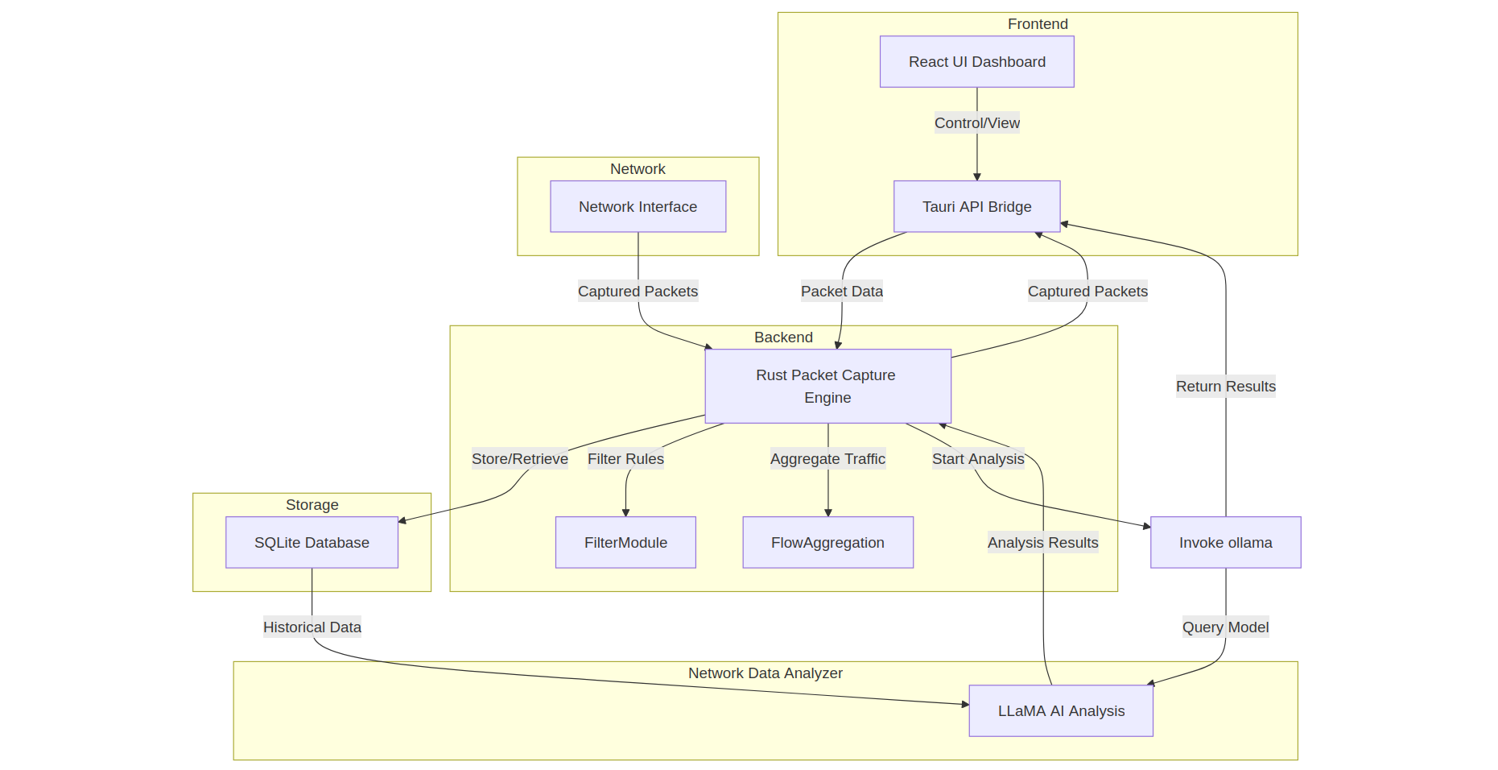
Architecture Diagram

Slide 7
System Architecture
Modular Desktop Application Architecture:
Frontend: Built using React, packaged with Tauri for native desktop deployment.
Backend: Built in Rust using pnet for packet capture and rusqlite for database storage. Additionally, makes use of oLlama, an open source utility for utilising Meta’s Llama models. This project specifically utilises the Llama 3.1 model, deployed locally.

Slide 8
System Architecture
Frontend Components:
React + Tauri:
React ensures a lightweight and highly responsive UI.
Tauri provides a desktop-native experience, optimizing performance and enabling seamless integration with the Rust backend.
Features minimalistic UI elements for clear data visualization.
Visualization:
Interactive graphs and charts (using Recharts) to show packet traffic over time(time-series line graphs), protocol distribution (pie charts), and other key network metrics.

Slide 9
System Architecture
Backend Components:
Rust Backend:
Fast and Safe Packet Capture: Rust ensures efficient and secure packet capture by leveraging the pnet library for low-level network interaction, allowing for real-time packet analysis with minimal performance overhead.
Database Storage and Querying: The rusqlite library is used to store captured packets in an SQLite database, enabling efficient querying and retrieval for detailed traffic analysis and reporting.
Local LLaMA Model Integration
The application integrates a local LLaMA 3.1 model for advanced packet analysis tasks, allowing packet data to be processed and analyzed for insights without relying on external servers, ensuring both privacy and performance.

Slide 10
Detailed Design
Frontend Design
React-based UI Design: The frontend of the application is built using React, within the Tauri framework, ensuring real-time updates without page reloads. Tauri allows for creating lightweight, cross-platform desktop applications by integrating web-based UIs with native system capabilities.
This design choice allows seamless data rendering for packet analysis. The state management is handled using React’s built-in hooks, ensuring efficient communication between the UI and the backend, where packet data is continuously fed and displayed.
Visual Component Design: We incorporated dynamic graphs and charts using libraries like Recharts.js to visualize packet data. The design process focused on creating a minimal, user-friendly interface with filtering options for protocols, IP addresses, and time ranges, keeping the interface simple while offering powerful insights into network traffic.

Slide 11
Detailed Design
Backend Design
Rust Packet Capture Engine:
The backend captures packets using Rust’s pnet library, ensuring high performance and safety for low-level network operations. The packet capture engine listens to the network interface, gathering metadata like source/destination IPs, protocol, and payload in multiple formats. This data is then structured for insertion into the database. The Tauri app communicates with the Rust backend via Tauri commands to request and display packet data in real time.
Database Interaction:
Data captured by the packet engine is stored using rusqlite in an SQLite database. The schema is designed to store metadata like source/destination IP, protocol, and timestamps. The frontend (React within Tauri) is able to fetch the SQLite database to display data in a formatted manner, with advanced methods like Pagination.

Slide 12
Detailed Design
AI Integration (LLaMA)
LLaMA Model Integration:
The Rust backend integrates Meta’s LLaMA 3.1:8b model, using the oLlama library, running locally within the Tauri app. This design ensures that no external server is required, keeping all AI analysis offline, hence contributing to increased security of packet data. The LLaMA model analyzes captured packets for anomalies such as suspicious IP addresses or unusual traffic patterns.
AI-Driven Insights within Tauri:
The insights generated by LLaMA are processed and returned to the Tauri frontend, where users are notified of anomalies in real-time. By utilizing Tauri’s ability to manage system-level processes, the app remains lightweight while offering powerful AI-based network traffic analysis on the user's local machine.

Slide 13
Tools and Technologies used
Frontend
React: JavaScript library for building the dynamic, responsive user interface.
Recharts: Used to create interactive charts and graphs that visualize packet data in real time.
Tauri: Rust Framework for creating lightweight desktop applications using web technologies (React frontend)
Backend
Rust: Provides high-performance, memory-safe execution for network packet capture and processing.
pnet: Rust library used to capture packets from the network interface.
rusqlite: SQLite binding in Rust for storing and querying captured packet data.
Others
Ollama’s Llama 3.1/3.2: Machine learning models used for packet analysis on a per packet basis.

Slide 14
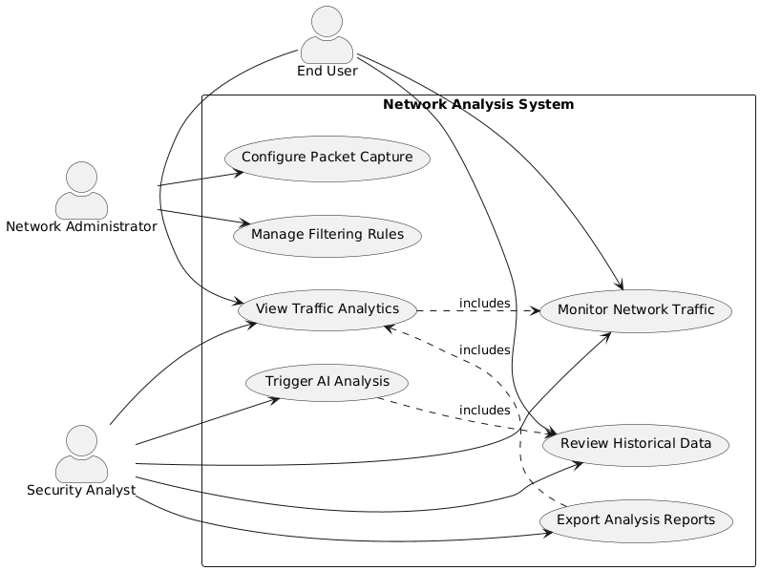
Use-Case Diagram

Slide 15
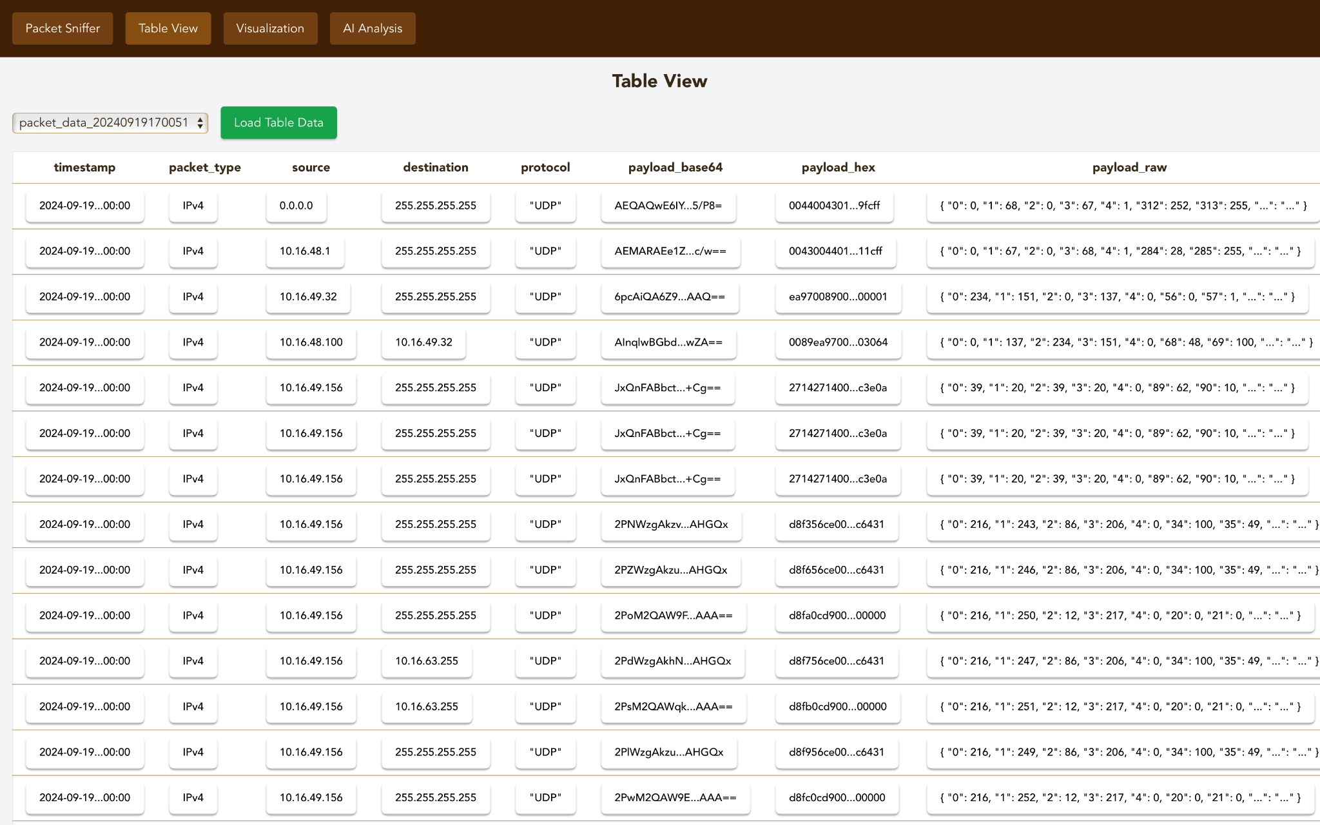
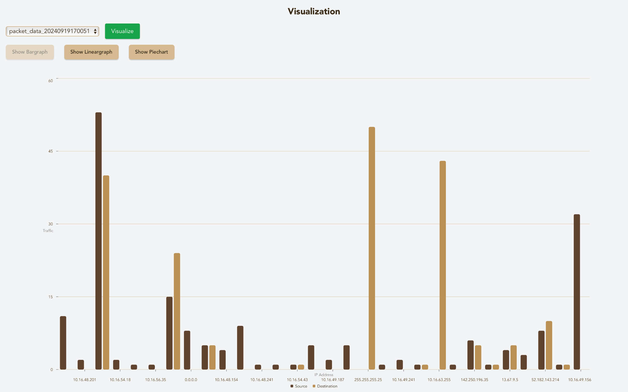
Screencaps
Table view
It allows to application user to view the data for the available data that is previously captured also it can be viewed as a singular datum.
Data visualization
It allows the user to view the data as graphical format in Bar Chart, Linear Graph and Pie chart format for data like IP as ( Destination & Source), Traffic Rate, Distribution of IP protocols.

Slide 16
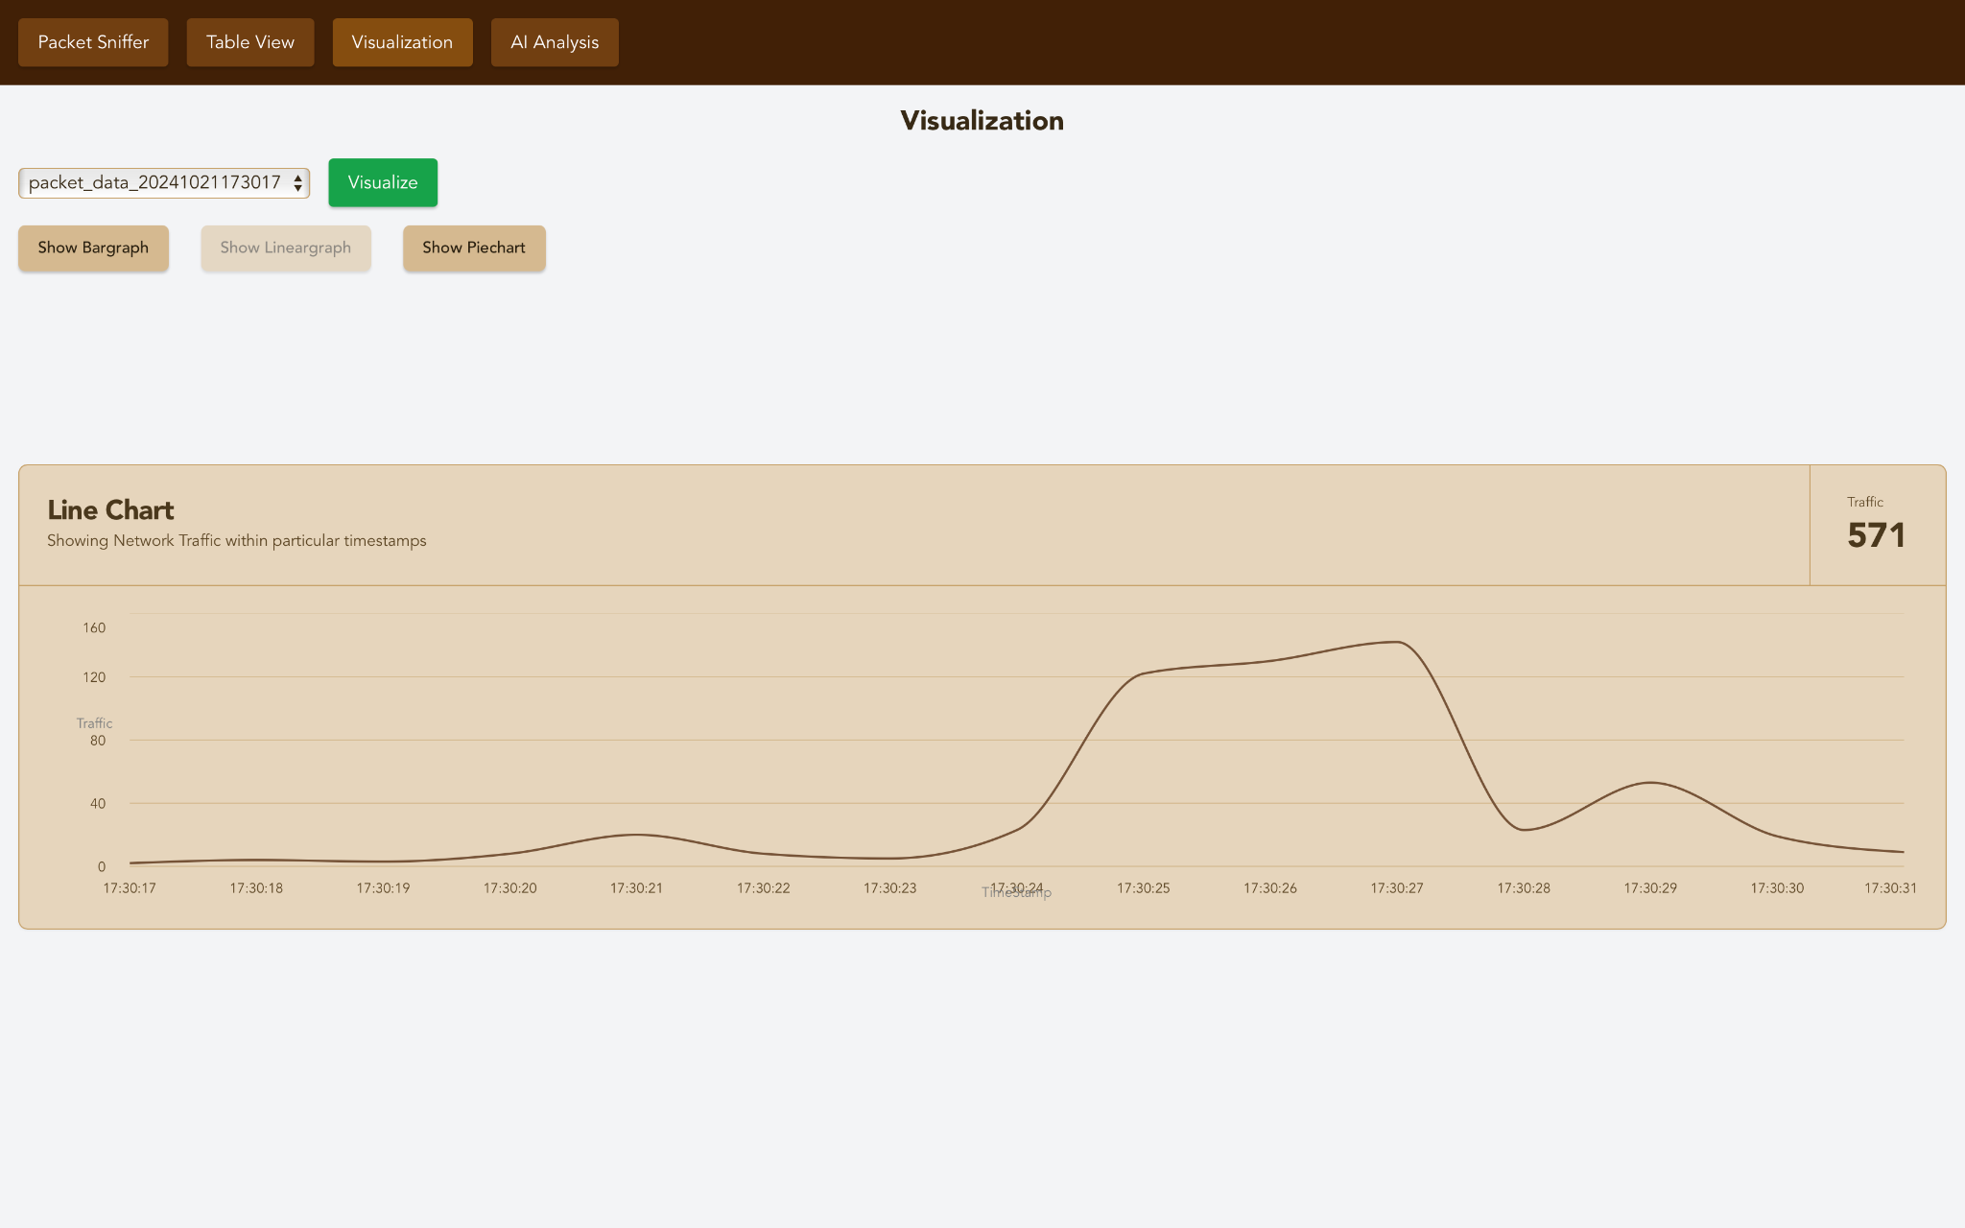
Screencaps

Slide 17
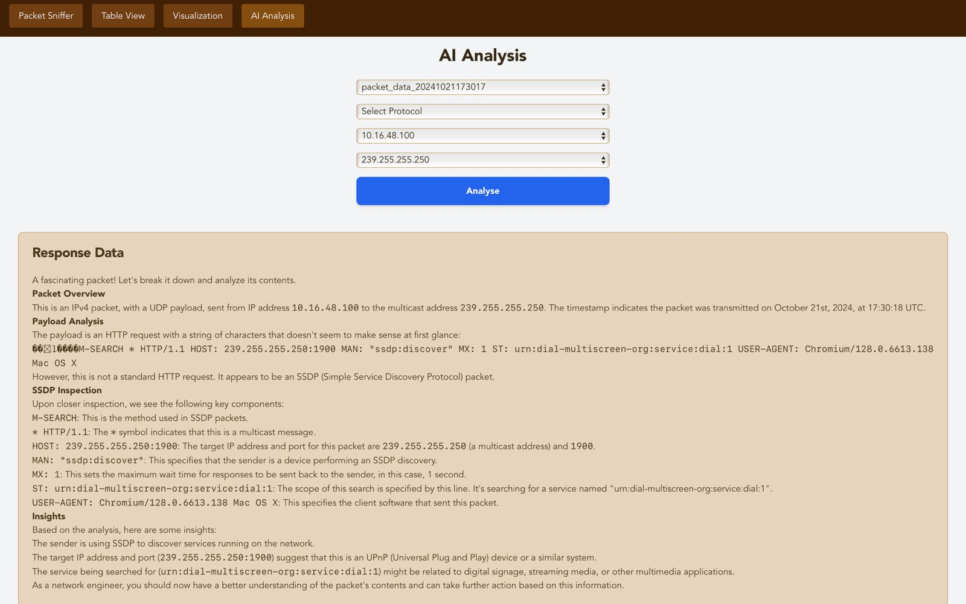
Screencaps

Slide 18
Results
We were able to build a full fledged desktop application, compatible on any system (Linux, macOS, Windows etc), that entails :
Real-time packet capture with high performance, minimal resource consumption, and a streamlined UI.
Streamlined view of packet data with all relevant information.
Visual feedback on network traffic via dynamic charts and graphs.
Llama 3.1 integration provides enhanced packet flow analysis, on a per packet basis, taking into account the metadata of each.

Slide 19
References
Rust Documentation
Tauri Documentation
React Documentation
Shadcn Documentation
Llama 3.1 Documentation
pnet.rs
libpnet-FFi

